Slide 1
Course
AWS Cloud Practitioner
MaxCloud

Slide 2
07
Class
Amazon S3
Amazon CloudFront
Global Accelerator

Slide 3
Amazon S3
Amazon Simple Storage Service (Amazon S3) is an object storage service that offers industry-leading scalability, data availability, security, and performance.
Customers of all sizes and industries can use Amazon S3 to store and protect any amount of data for a range of use cases, such as data lakes, websites, mobile applications, backup and restore, archive, enterprise applications, IoT devices, and big data analytics.
Amazon S3 provides management features so that you can optimize, organize, and configure access to your data to meet your specific business, organizational, and compliance requirements.

Slide 4
Buckets
To store your data in Amazon S3, you work with resources known as buckets and objects. A bucket is a container for objects. An object is a file and any metadata that describes that file.
To store an object in Amazon S3, you create a bucket and then upload the object to a bucket. When the object is in the bucket, you can open it, download it, and move it. When you no longer need an object or a bucket, you can clean up your resources.

Slide 5
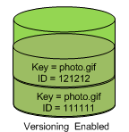
Versioning
You can use S3 Versioning to keep multiple versions of an object in one bucket so that you can restore objects that are accidentally deleted or overwritten.
https://docs.aws.amazon.com/AmazonS3/latest/userguide/versioning-workflows.html

Slide 6
Replicating objects
Replication enables automatic, asynchronous copying of objects across Amazon S3 buckets.
Buckets that are configured for object replication can be owned by the same AWS account or by different accounts.
Replication types:
Cross-Region Replication
Same-Region Replication
two-way replication

Slide 7
Storage classes
S3 Standard
S3 Intelligent-Tiering
S3 Express One Zone
S3 Standard-IA
S3 One Zone-IA
S3 Glacier Instant Retrieval
S3 Glacier Flexible Retrieval
S3 Glacier Deep Archive
https://aws.amazon.com/s3/storage-classes/

Slide 8
Amazon Cloudfront
Amazon CloudFront is a web service that speeds up distribution of your static and dynamic web content, such as .html, .css, .js, and image files, to your users. CloudFront delivers your content through a worldwide network of data centers called edge locations.
When a user requests content that you're serving with CloudFront, the request is routed to the edge location that provides the lowest latency (time delay), so that content is delivered with the best possible performance.

Slide 9
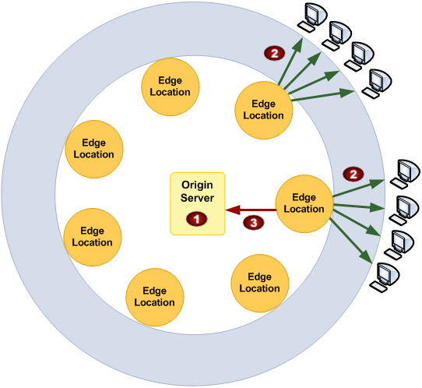
Amazon Cloudfront

Slide 10
AWS Global Accelerator
AWS Global Accelerator is a networking service that helps you improve the availability, performance, and security of your public applications.
Global Accelerator provides two global static public IPs that act as a fixed entry point to your application endpoints, such as Application Load Balancers, Network Load Balancers, Amazon Elastic Compute Cloud (EC2) instances, and elastic IPs.

Slide 11
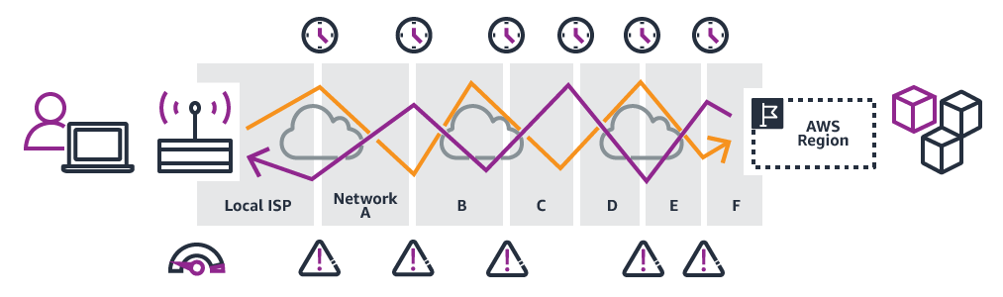
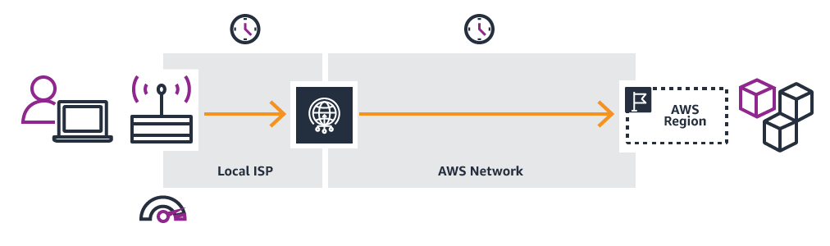
AWS Global Accelerator

Slide 12
Muchas Gracias

